Slide 1
Team B - Final Presentation
Sudin Amatya, Abby Demers, Curtis Ellison, Joshua May, Connor McDonald

Slide 2
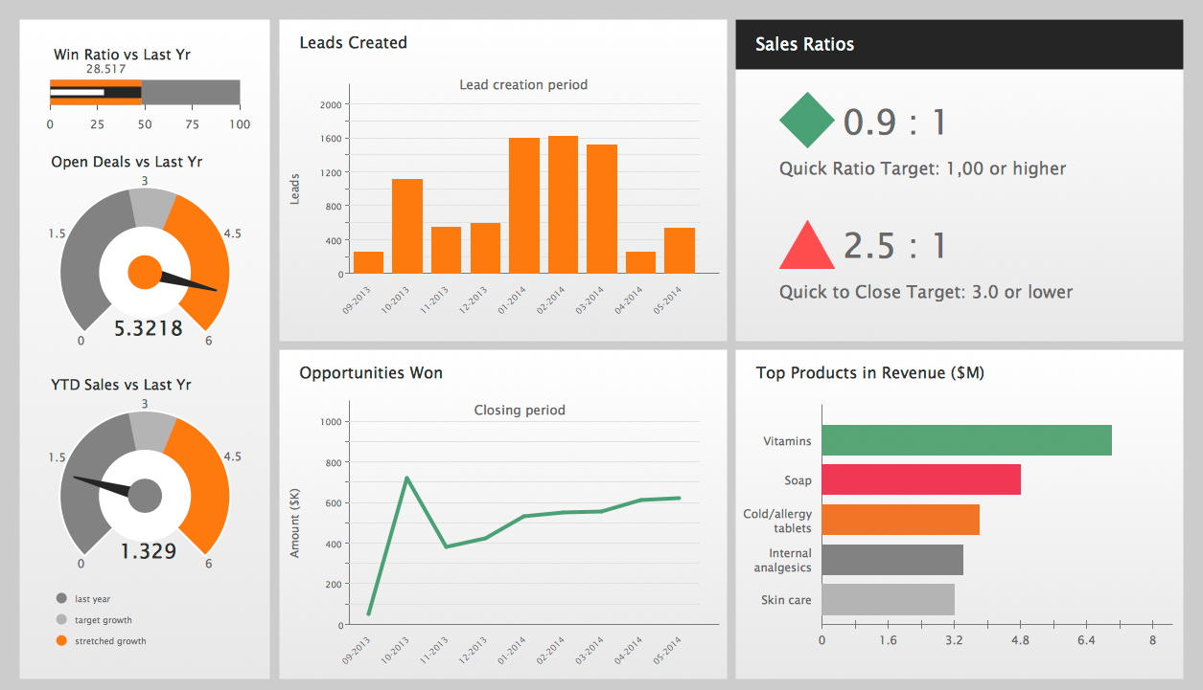
About
Creation of a visualization dashboard
Dashboard shows collaboration analytics
Uses game data
Fuses technologies and techniques
inst490-analytics-dashboard.herokuapp.com
This Photo by Unknown Author is licensed under CC BY-NC-ND

Slide 3
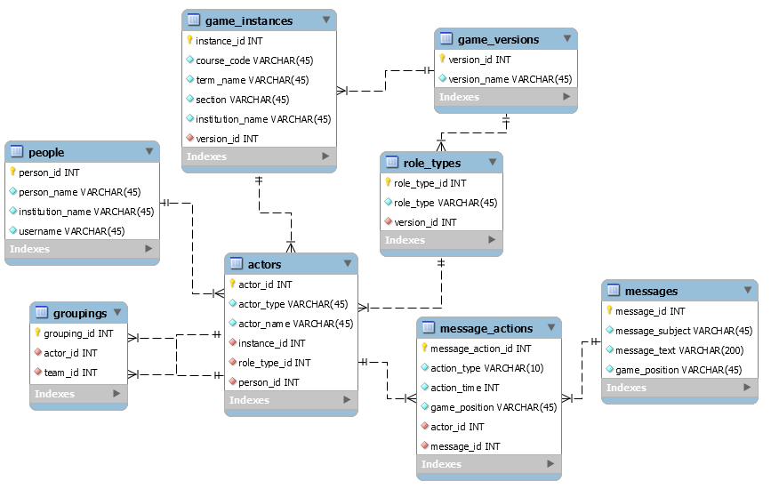
Development - Database
Created in MySQL Workbench
Focuses on message exchanges
People grouped into teams
Messages sent individually or as team
Manually Coded Test Data
inst490-analytics-dashboard.herokuapp.com

Slide 4
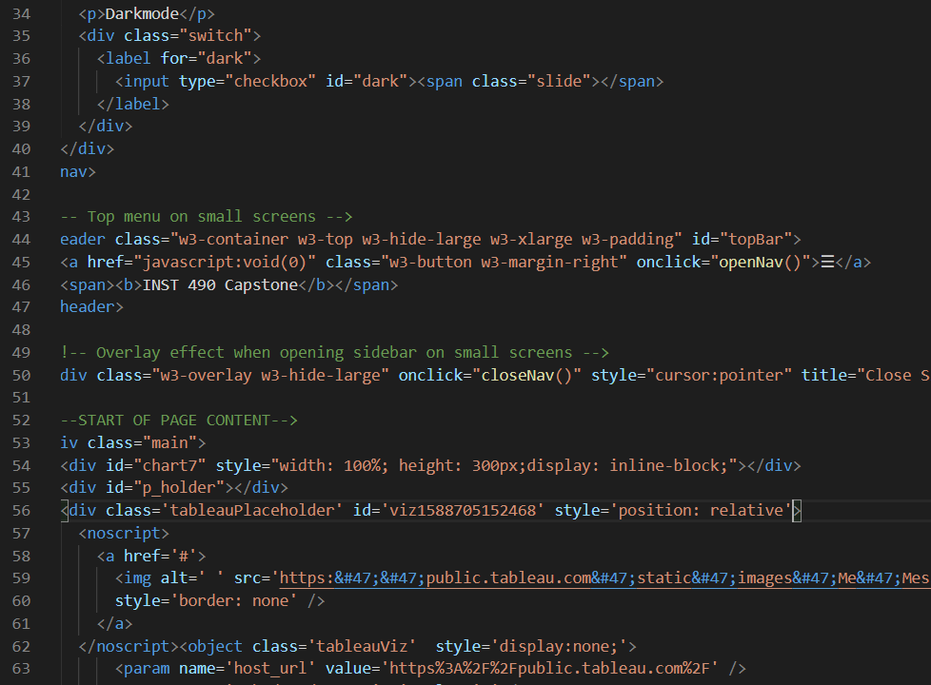
Development - Dashboard
Created in HTML
Uses JavaScript
Designed with CSS
Syncs with database
Facilitated by GitHub
Data
Server: nodeJS
Database: BlueHost
inst490-analytics-dashboard.herokuapp.com

Slide 5

Design
Wireframed in Paint and PowerPoint
Logo made in PowerPoint
Page designed wtih CSS
inst490-analytics-dashboard.herokuapp.com
This Photo by Unknown Author is licensed under CC BY

Slide 6

Interpersonal Communication
GroupMe
Zoom
inst490-analytics-dashboard.herokuapp.com
This Photo by Unknown Author is licensed under CC BY-SA

Slide 7
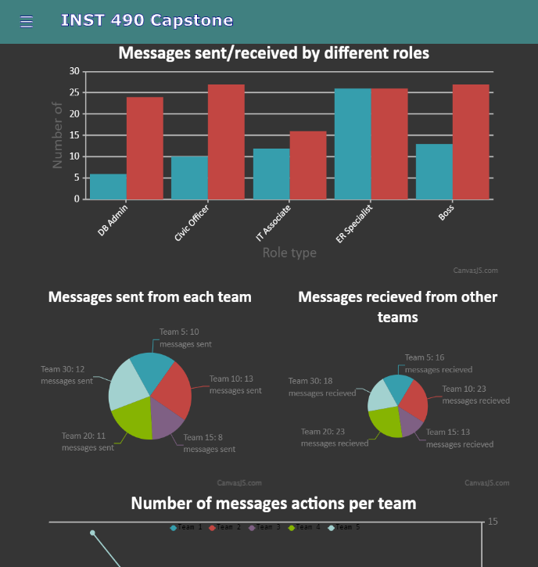
Deliverables
Interactive dashboard
inst490-analytics-dashboard.herokuapp.com

